Slide 1
Identifying and Creating Equivalent Fractions
Miss L
Year 7

Slide 2
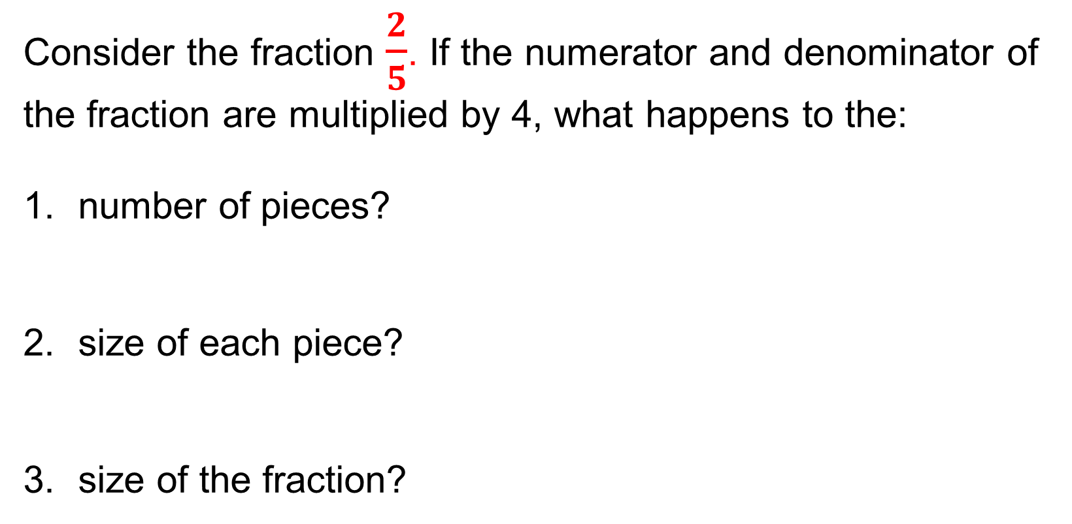
From Last Lesson
Consider the fraction $\frac{2}{5}$. If the numerator and denominator of the fraction are multiplied by 4, what happens to the:
number of pieces?
size of each piece?
size of the fraction?
Notes:
The 2 pieces become 8, which is four times greater.
The size of each piece becomes 4 times smaller.
The fraction 8/20 is the same size as the fraction 2/5.

Slide 3
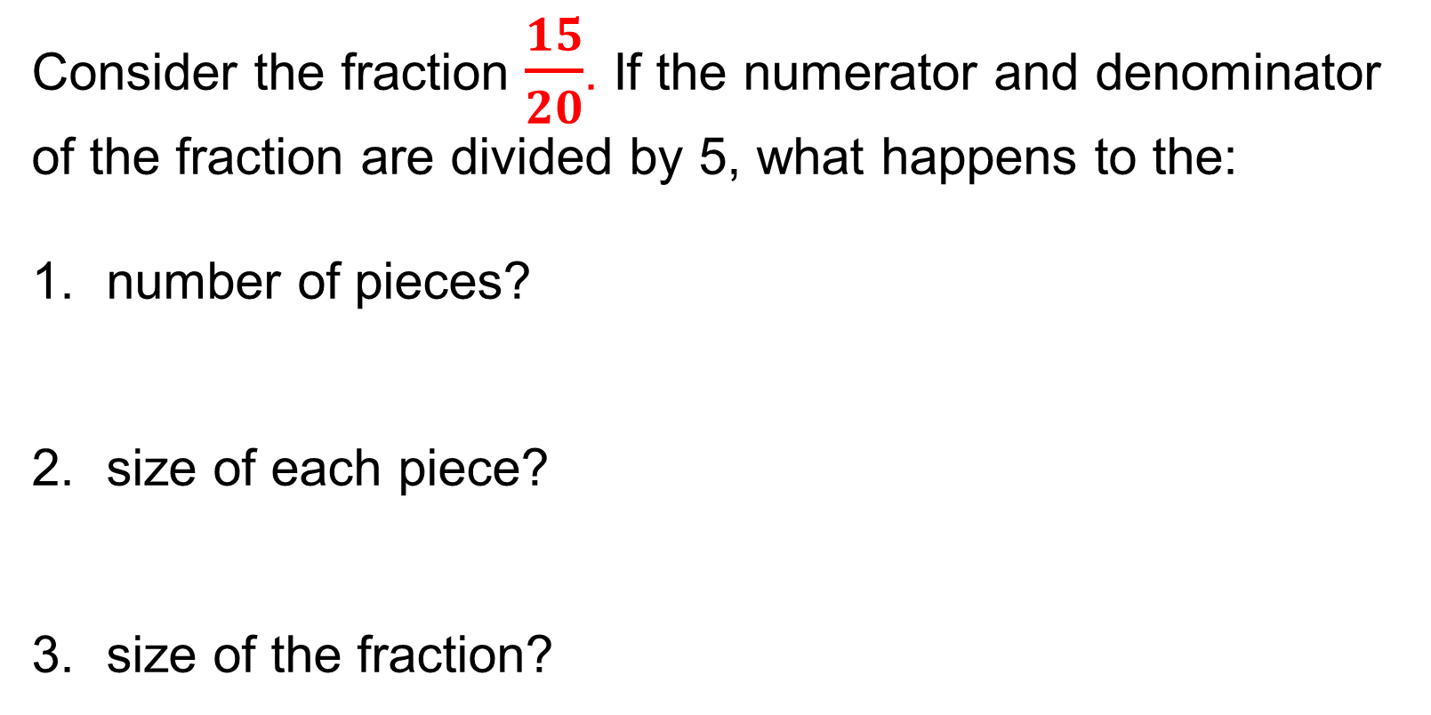
From Last Lesson
Consider the fraction $\frac{15}{20}$. If the numerator and denominator of the fraction are divided by 5, what happens to the:
number of pieces?
size of each piece?
size of the fraction?
Notes:
The 15 pieces become 3, which is five times smaller.
The size of each piece becomes 5 times greater.
The fraction 15/20 is the same size as the fraction 3/4.

Slide 4
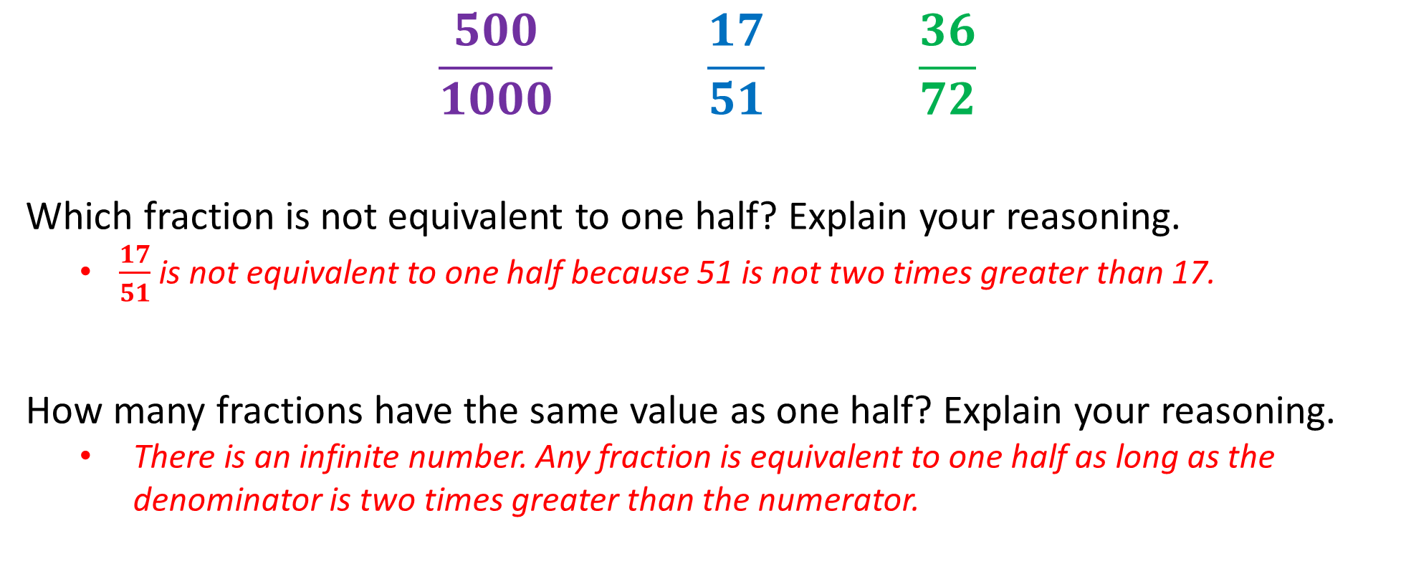
24
7
30
Equivalent Fractions
Date
EQ – How do we identify and create equivalent fractions?
$$\frac{500}{1000} \frac{17}{51} \frac{36}{72}$$
Which fraction is not equivalent to one half? Explain your reasoning.
  $\frac{17}{51}$ is not equivalent to one half because 51 is not two times greater than 17.
How many fractions have the same value as one half? Explain your reasoning.
  There is an infinite number. Any fraction is equivalent to one half as long as the denominator is two times greater than the numerator.
Notes:
Explain that this is the multiplicative relationship between the numerator and denominator and can be used to identify fractions that are equivalent to one half.

Slide 5
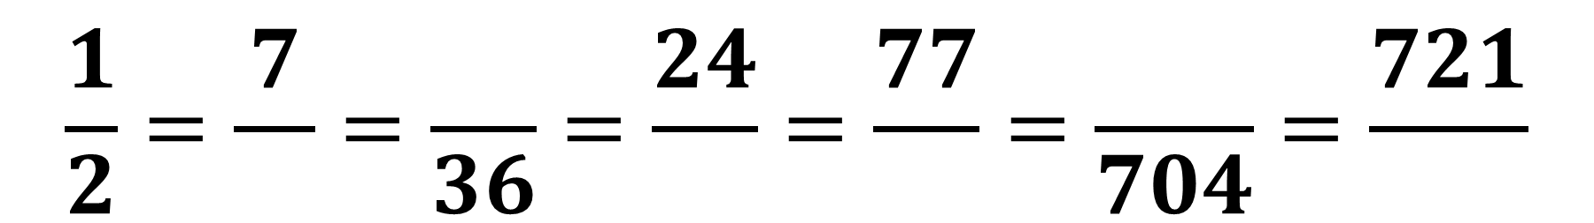
Practice
$$\frac{1}{2}=\frac{7}{}=\frac{}{36}=\frac{24}{}=\frac{77}{}=\frac{}{704}=\frac{721}{}$$
How would you work out the missing numbers in this equation?
Notes:
As all these fractions are equivalent to one half, the denominator must be two times greater than the numerator.
If given the numerator, it must be multiplied by two to find the denominator.
If given the denominator, it must be divided by two to find the numerator.
Explain that the multiplicative comparison of the numerator and denominator can be used to quickly identify equivalent forms of other unit fractions.

Slide 6

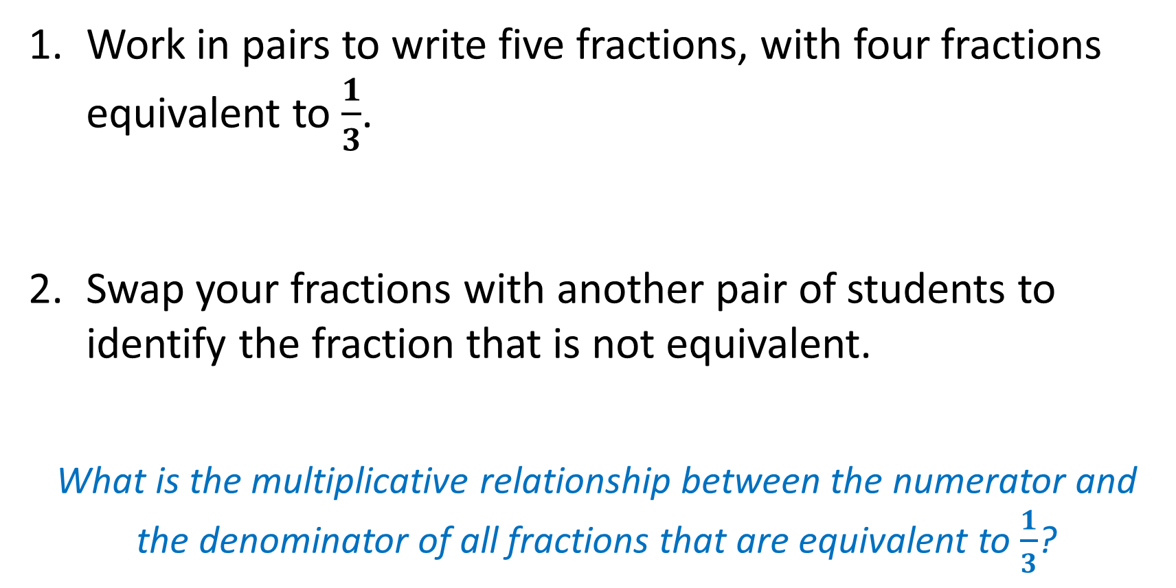
Task
Work in pairs to write five fractions, with four fractions equivalent to $\frac{1}{3}$.
Swap your fractions with another pair of students to identify the fraction that is not equivalent.
What is the multiplicative relationship between the numerator and the denominator of all fractions that are equivalent to $\frac{1}{3}$?
WICOR
Notes:
For all fractions equivalent to one third, the denominator must be three times greater than the numerator.

Slide 7


Slide 8
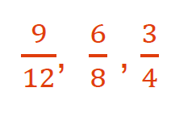
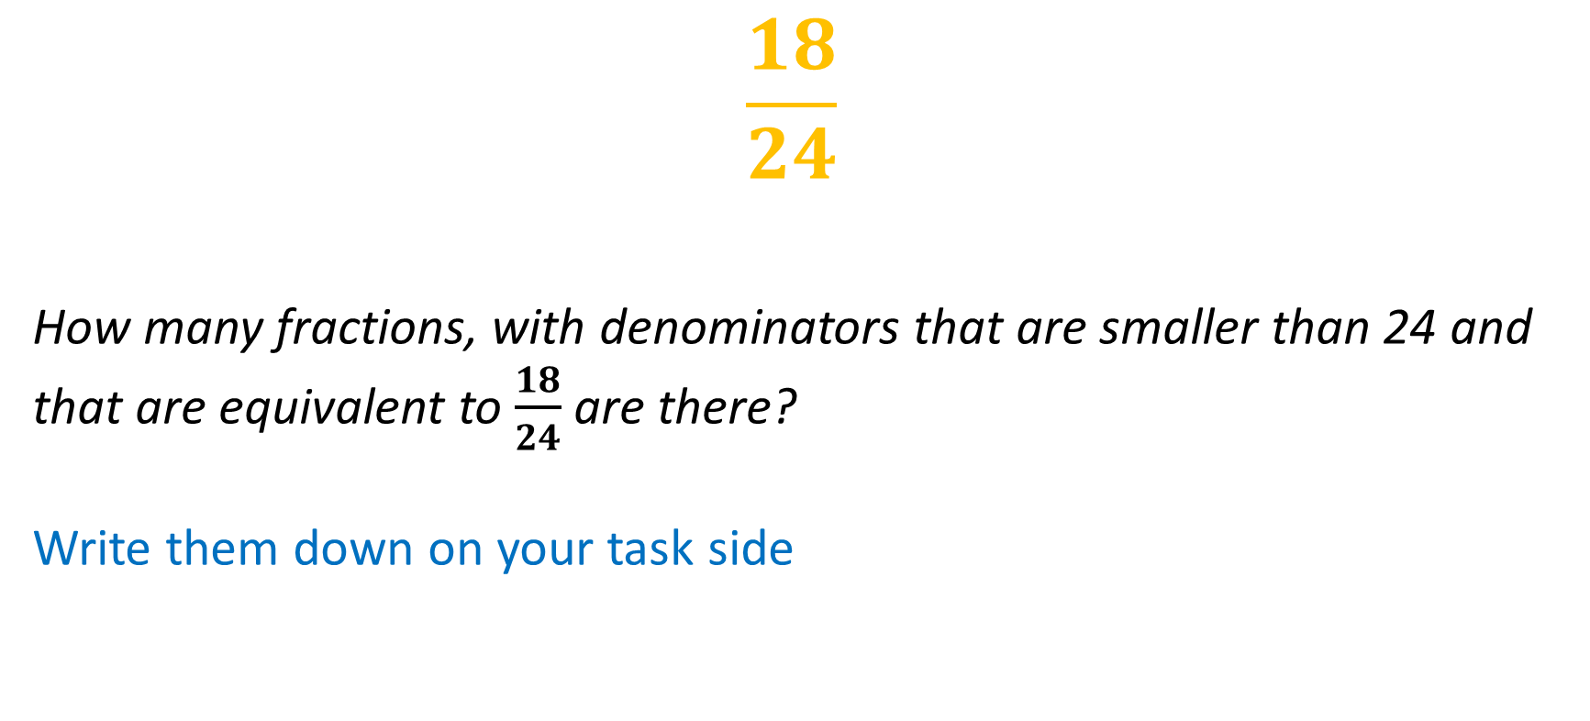
Task 1
$$\frac{18}{24}$$
How many fractions, with denominators that are smaller than 24 and that are equivalent to $\frac{18}{24}$ are there?
Write them down on your task side
What numbers did you use to divide both the numerator and denominator to find these equivalent fractions?
2, 3 and 6
Notes:
Explain that these numbers (2,3 and 6) are factors of both 18 and 24 and are called common factors of 18 and 24.

Slide 9
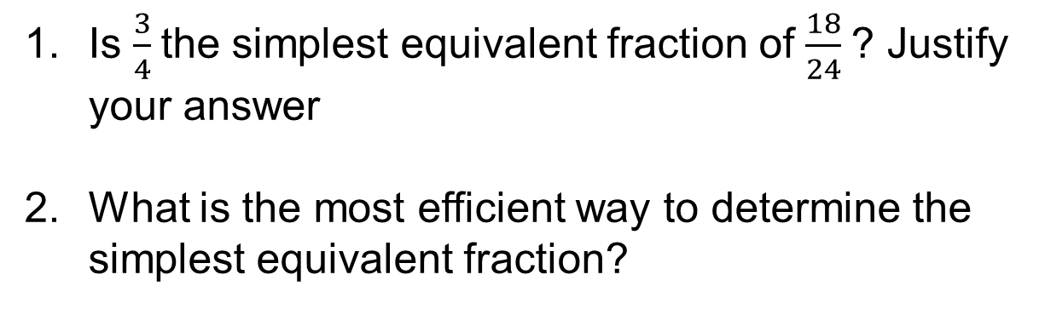
Task 1
Is $\frac{3}{4}$ the simplest equivalent fraction of $\frac{18}{24}$ ? Justify your answer
What is the most efficient way to determine the simplest equivalent fraction?
Notes:
3/4 is the simplest equivalent fraction because 1 is the only common factor of 3 and 4. Dividing the numerator and denominator by 1 will not simplify the fraction.
The simplest way is to divide the numerator and denominator by their highest common factor. In this example the numerator and denominator are divided by 6. The same answer can be achieved through a number of divisions using other common factors, in this example dividing the numerator and denominator by 2 then 3, or 3 then 2, but this is less efficient.

Slide 10
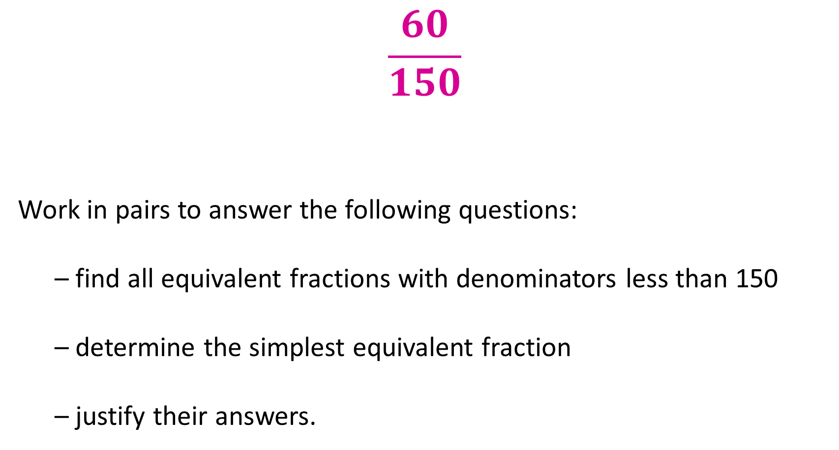
Task 2
$$\frac{60}{150}$$
Work in pairs to answer the following questions:
  – find all equivalent fractions with denominators less than 150
  – determine the simplest equivalent fraction
  – justify their answers.
WICOR

Slide 11
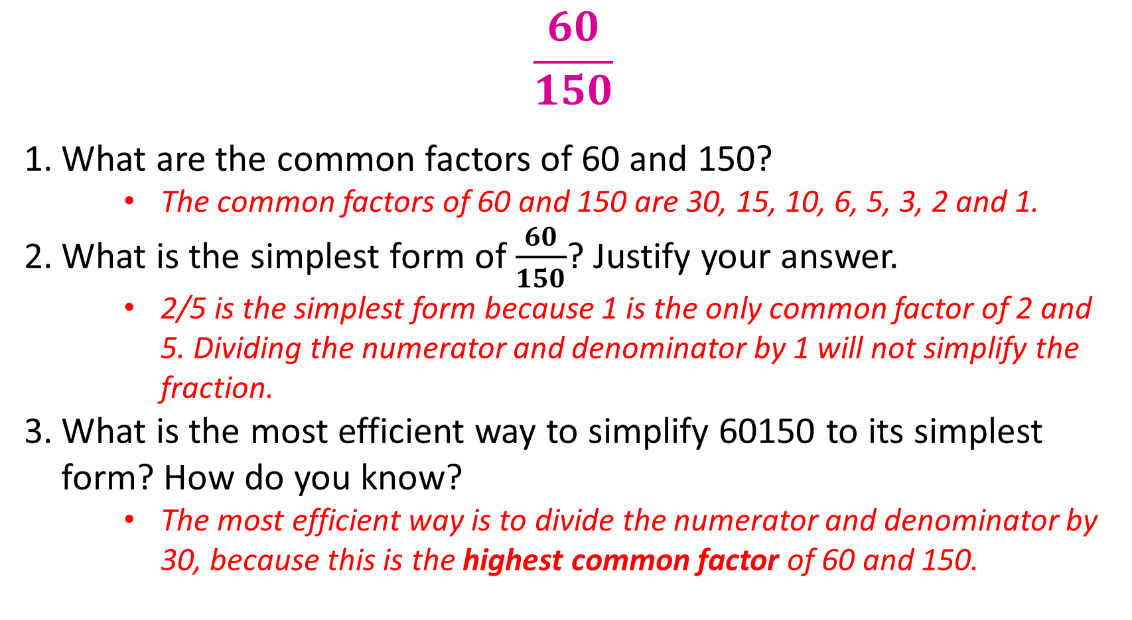
Task 2
$$\frac{60}{150}$$
What are the common factors of 60 and 150?
    The common factors of 60 and 150 are 30, 15, 10, 6, 5, 3, 2 and 1.
What is the simplest form of $\frac{60}{150}$? Justify your answer.
    2/5 is the simplest form because 1 is the only common factor of 2 and 5. Dividing the numerator and denominator by 1 will not simplify the fraction.
What is the most efficient way to simplify 60150 to its simplest form? How do you know?
    The most efficient way is to divide the numerator and denominator by 30, because this is the highest common factor of 60 and 150.

Slide 12
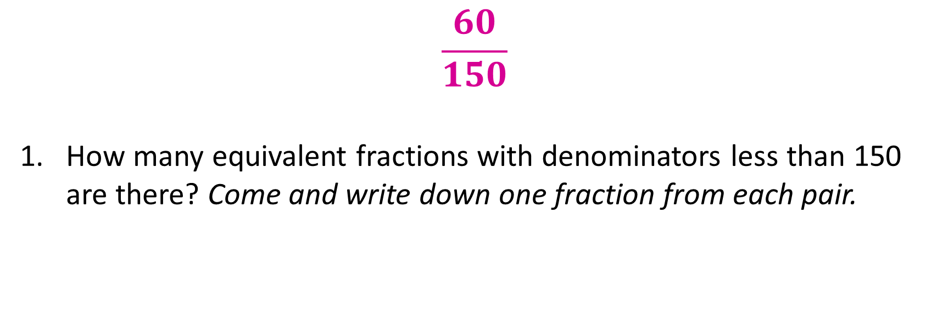
Task 2
$$\frac{60}{150}$$
How many equivalent fractions with denominators less than 150 are there? Come and write down one fraction from each pair.
Notes:
4/10 6/15
2/5 30/75
20/50 10/25 12/30

